Slide 1

ON THE DETERMATION OF THREE PAREMETER WEIBULL MLE’S
The probability density function for the weibull distribution is
$f\left(x;u,v,w\right)=\frac{w}{v}({x−u)}^{w−1}e^{− \frac{{(x−u)}^{w}}{v}}$,
for 0 ≤ u ≤ $x_{j}$ , j = 1, 2, …….n
v ,w > 0
where u, v, w are the location, scale and shape parameters respectively and
$x_{j}^{′}s are the observed values of the random variable.$

Slide 2

Our goal is to estimate the parameters u, v , w by the method of maximum likelihood by using the programming language R.
The log likelihood function can be obtained from the pdf of
Weibull distribution as follows;
$f\left(x;u,v,w\right)=\frac{w}{v} ({x−u)}^{w−1}e^{− \frac{{(x−u)}^{w}}{v}}$
L = $ln\prod{(\frac{ w}{v}}{{(x}_{j}−u)}^{w−1})e^{− \frac{{\left(x_{j}−u\right)}^{w}}{v} })$
L =$\sum{{{ln(\frac{ w}{v}(x}_{j}−u)}^{w−1}{(e}^{−\frac{{\left(x_{j}−u\right)}^{w}}{v} }))}$
L =$\sum{({{ln(\frac{ w}{v})+ln(x}_{j}−u)}^{w−1}−\frac{{\left(x_{j}−u\right)}^{w}}{v} )}$
L =$N \ln{(}\frac{w}{v})−\frac{1}{v} \sum{{{(x}_{j}−u)}^{w}}+(w−1)\sum{ln(x_{j}−u)}$

Slide 3

Maximizing the log- likelihood function;
L =$N \ln{(}\frac{w}{v})−\frac{1}{v} \sum{{{(x}_{j}−u)}^{w}}+\left(w−1\right)\sum{\ln\left(x_{j}−u\right)}$ (1)
The three parameters usually determined by the solution of the following likelihood equations;
$\frac{∂L}{∂u}=\frac{w}{v} \sum{{{(x}_{j}−u)}^{w−1}}−(w−1)\sum{{(x_{j}−u)}^{−1}}$= 0 (2)
$\frac{∂L}{∂v}=− \frac{N}{v}+\frac{1}{v^{2}}\sum{{(x_{j}−u)}^{w}}$ = 0 (3)
$\frac{∂L}{∂w}=\frac{N}{w }+\sum{ln(x_{j}−u)}−\frac{1}{v}\sum{{(x_{j}−u)}^{w}}$ $ln(x_{j}−u)$ = 0 (4)

Slide 4
Using the data of Rockette et al. in R script
Panchang and Gupta found u = 3.1, v = 1.925, w = 1.
We found
u = 3.0999, v = 1.925, w = 1.

Slide 5
Using the data from Petruaskas and Aagaard in R
We found
u = 11.0303, v = 40.2870, w = 1.5032.
Panchang and Gupta found u = 11, v = 41.4, w = 1.51.

Slide 6
Using the data of Adatia and Chan in R
We found
u = 10.0805, v = 0.8610, w = 1.
Panchang and Gupta found u = 10.0805, v = 0.861, w = 1.

Slide 7
Using the data from Smith and Naylor in R
u = 0, v = 16.7574, w = 5.7820

Slide 8
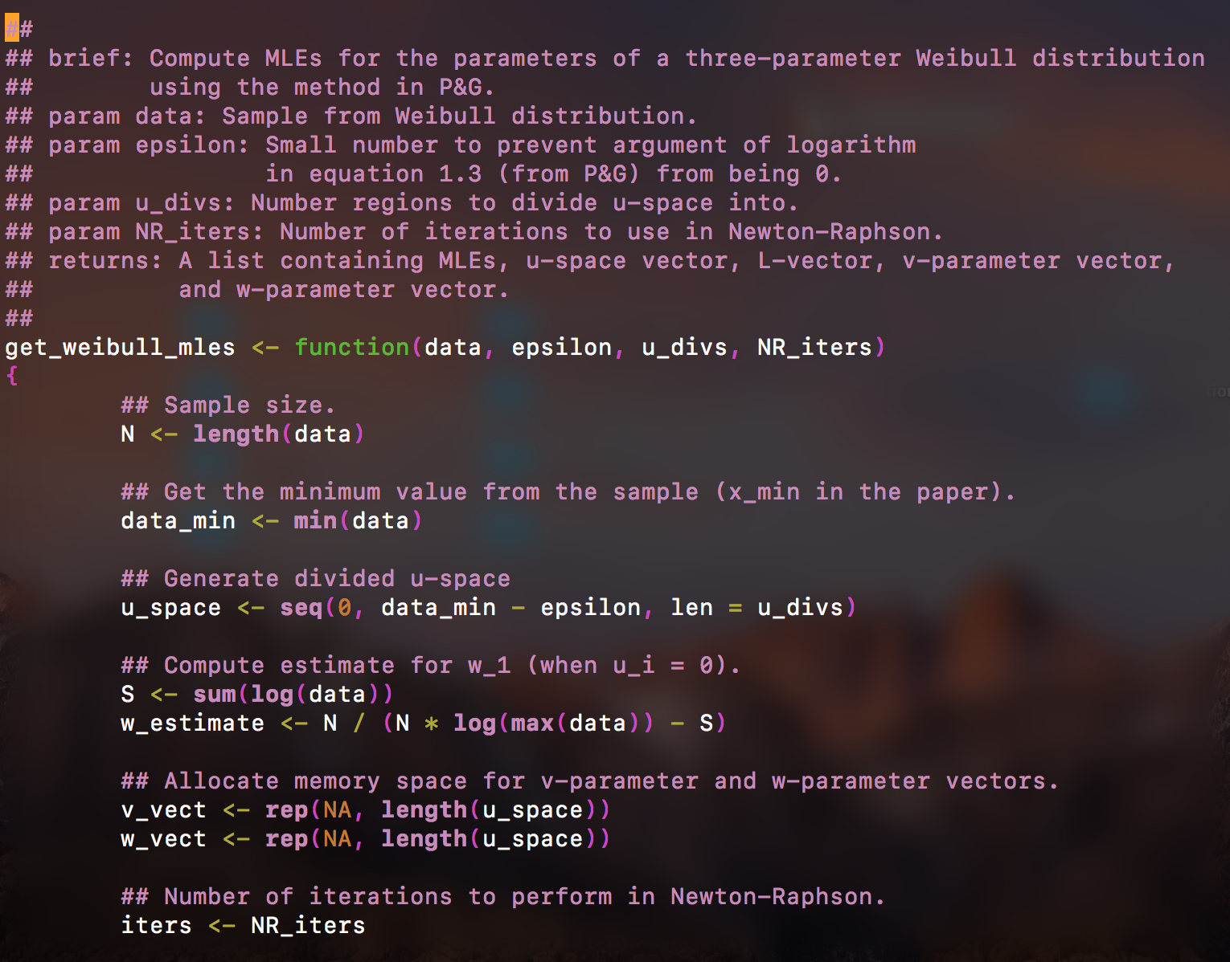
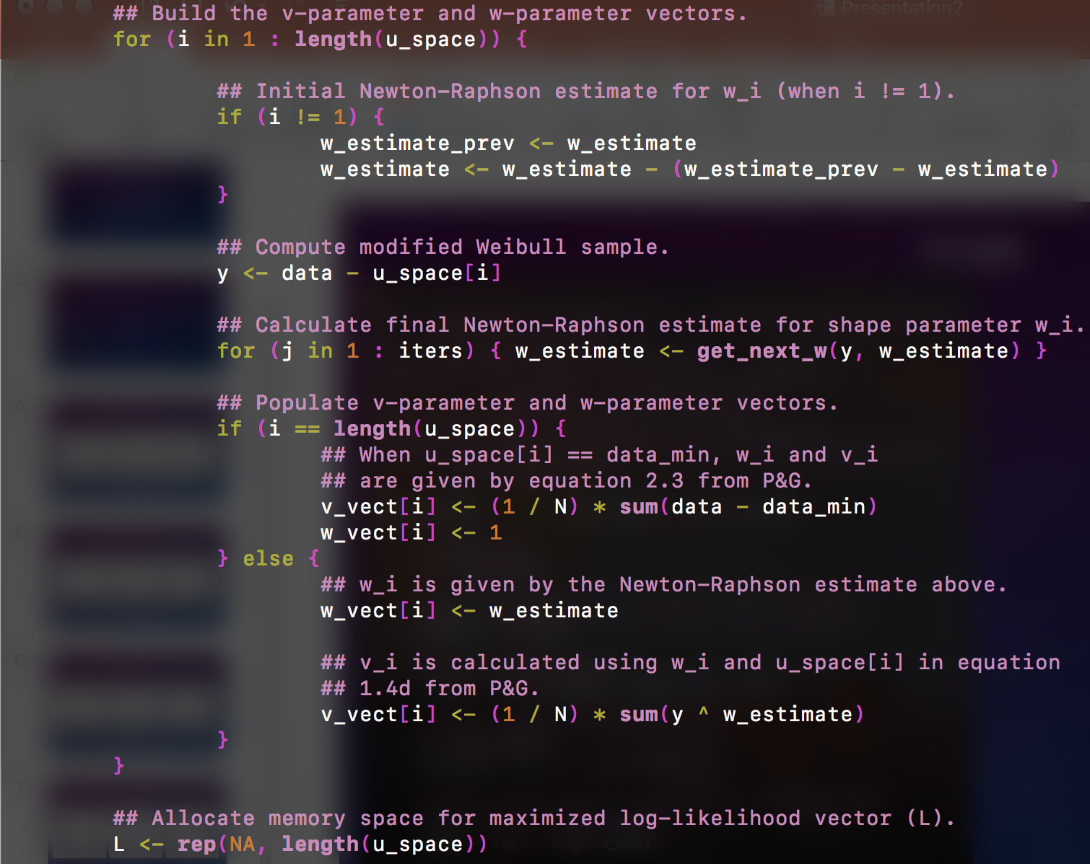
Solve for w_i using equation 2.1 and N-R.
Then solve for v_i using equation 1.4d.
Generate u space mentioned on page 1041.

Slide 9
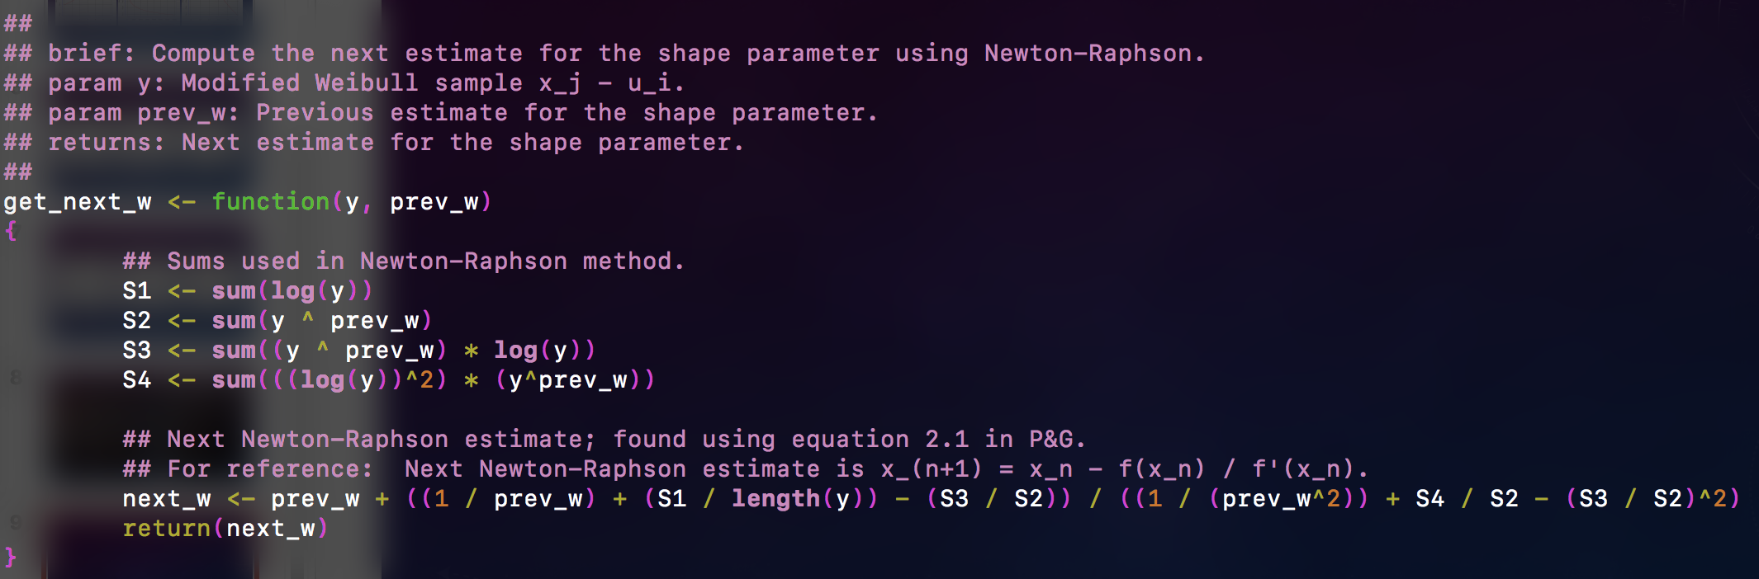
Newton-Raphson estimate function.
Formula for next_w derived using equation 2.1 and its first derivative.
Summation terms arranged so as to avoid NaNs as much as possible.

Slide 10
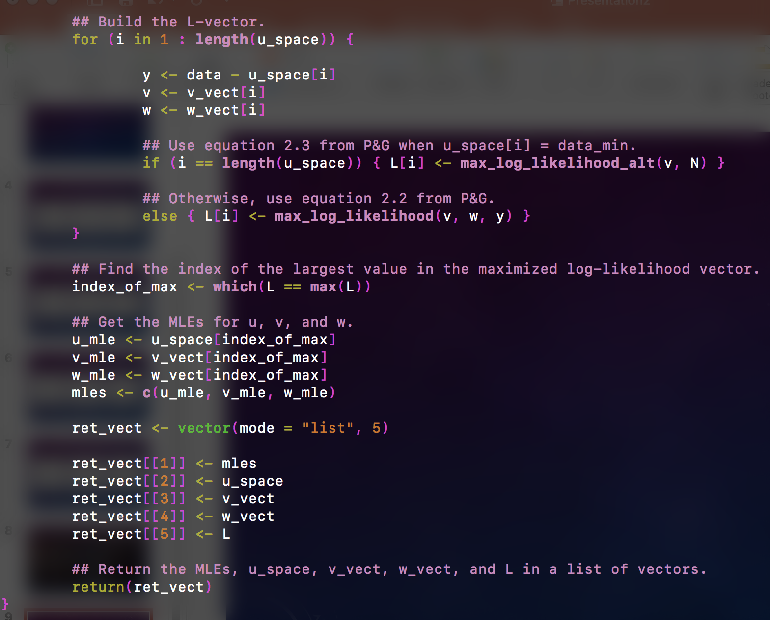
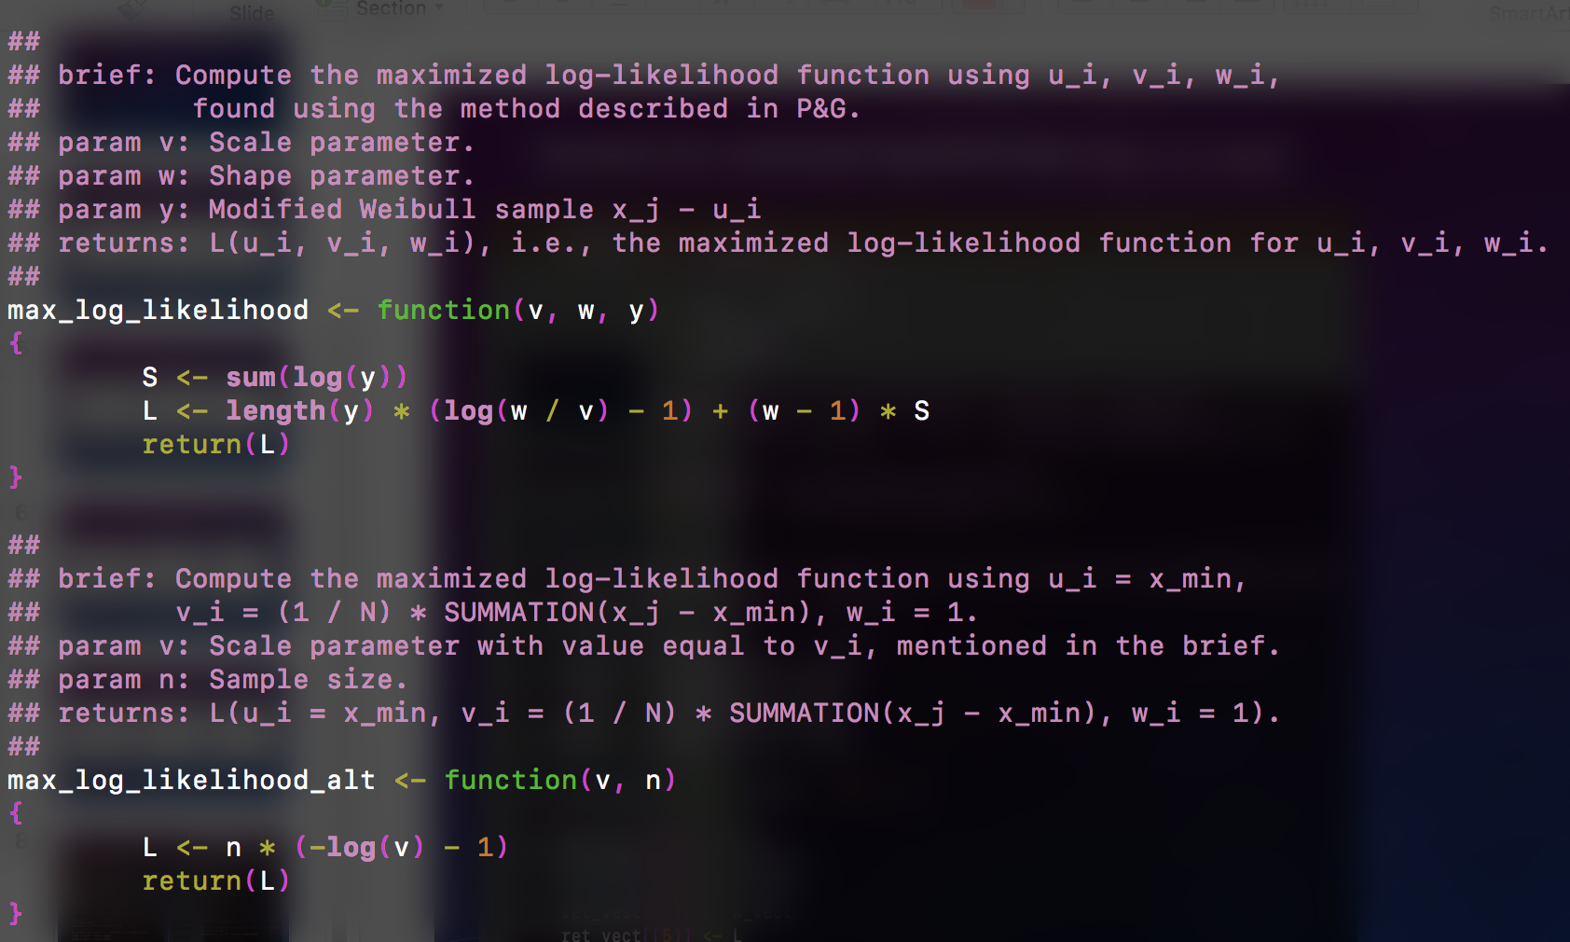
Compute the maximized log-likelihoods, L(u_i, v_i, w_i).
Then find out which one is the largest and extract its index.
Finally, use index to get MLEs.
The top function is equation 2.2.
The bottom function is equation 2.3,
which is used when u_i equals the minimum
observed value of the random variable.

Slide 11
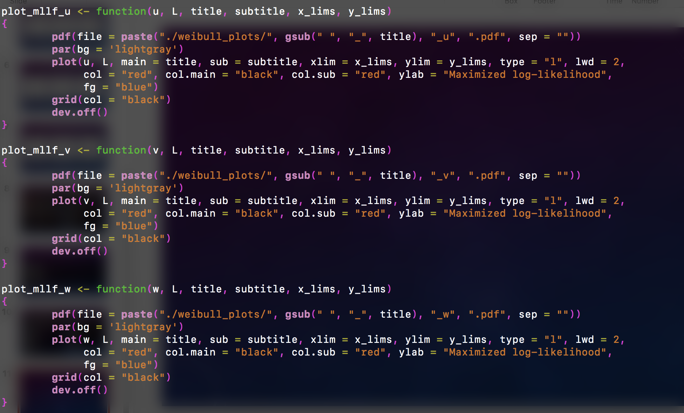
Plotting functions that generated the plots shown earlier.

Slide 12
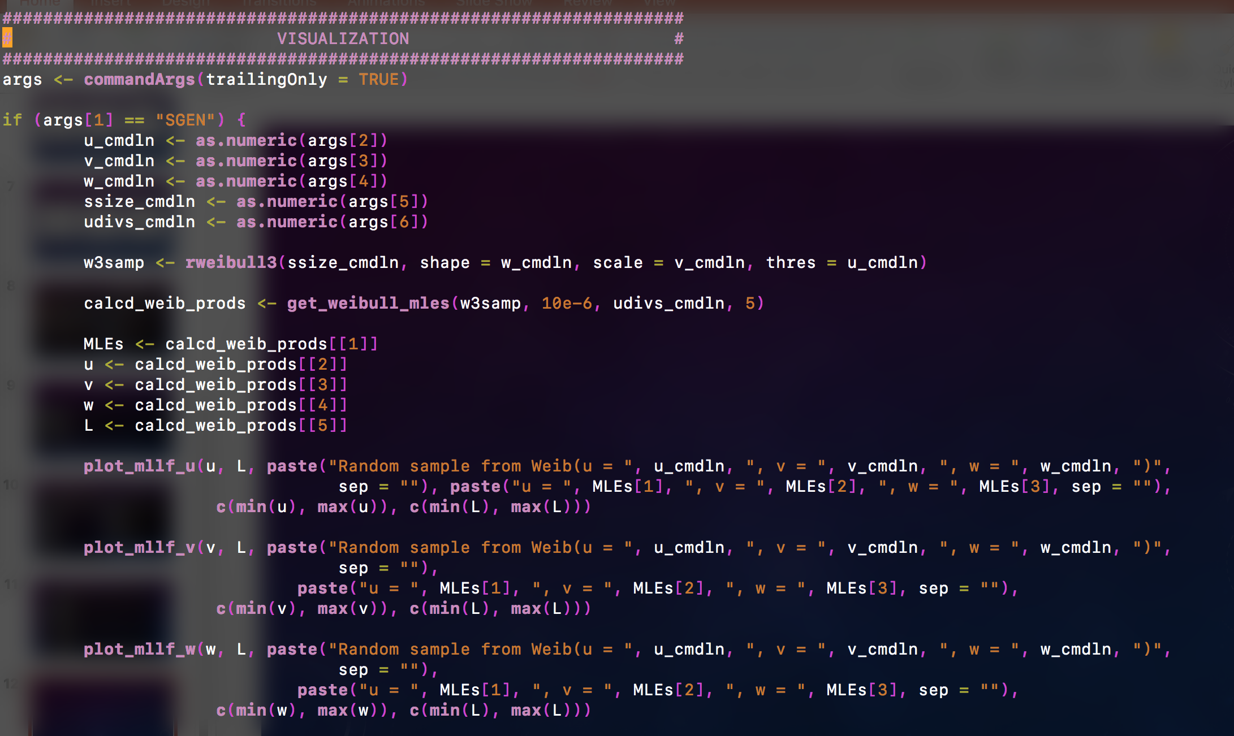
Specifying what to plot from the command line.
The function rweibull3() from library FAdist is used.

Slide 13
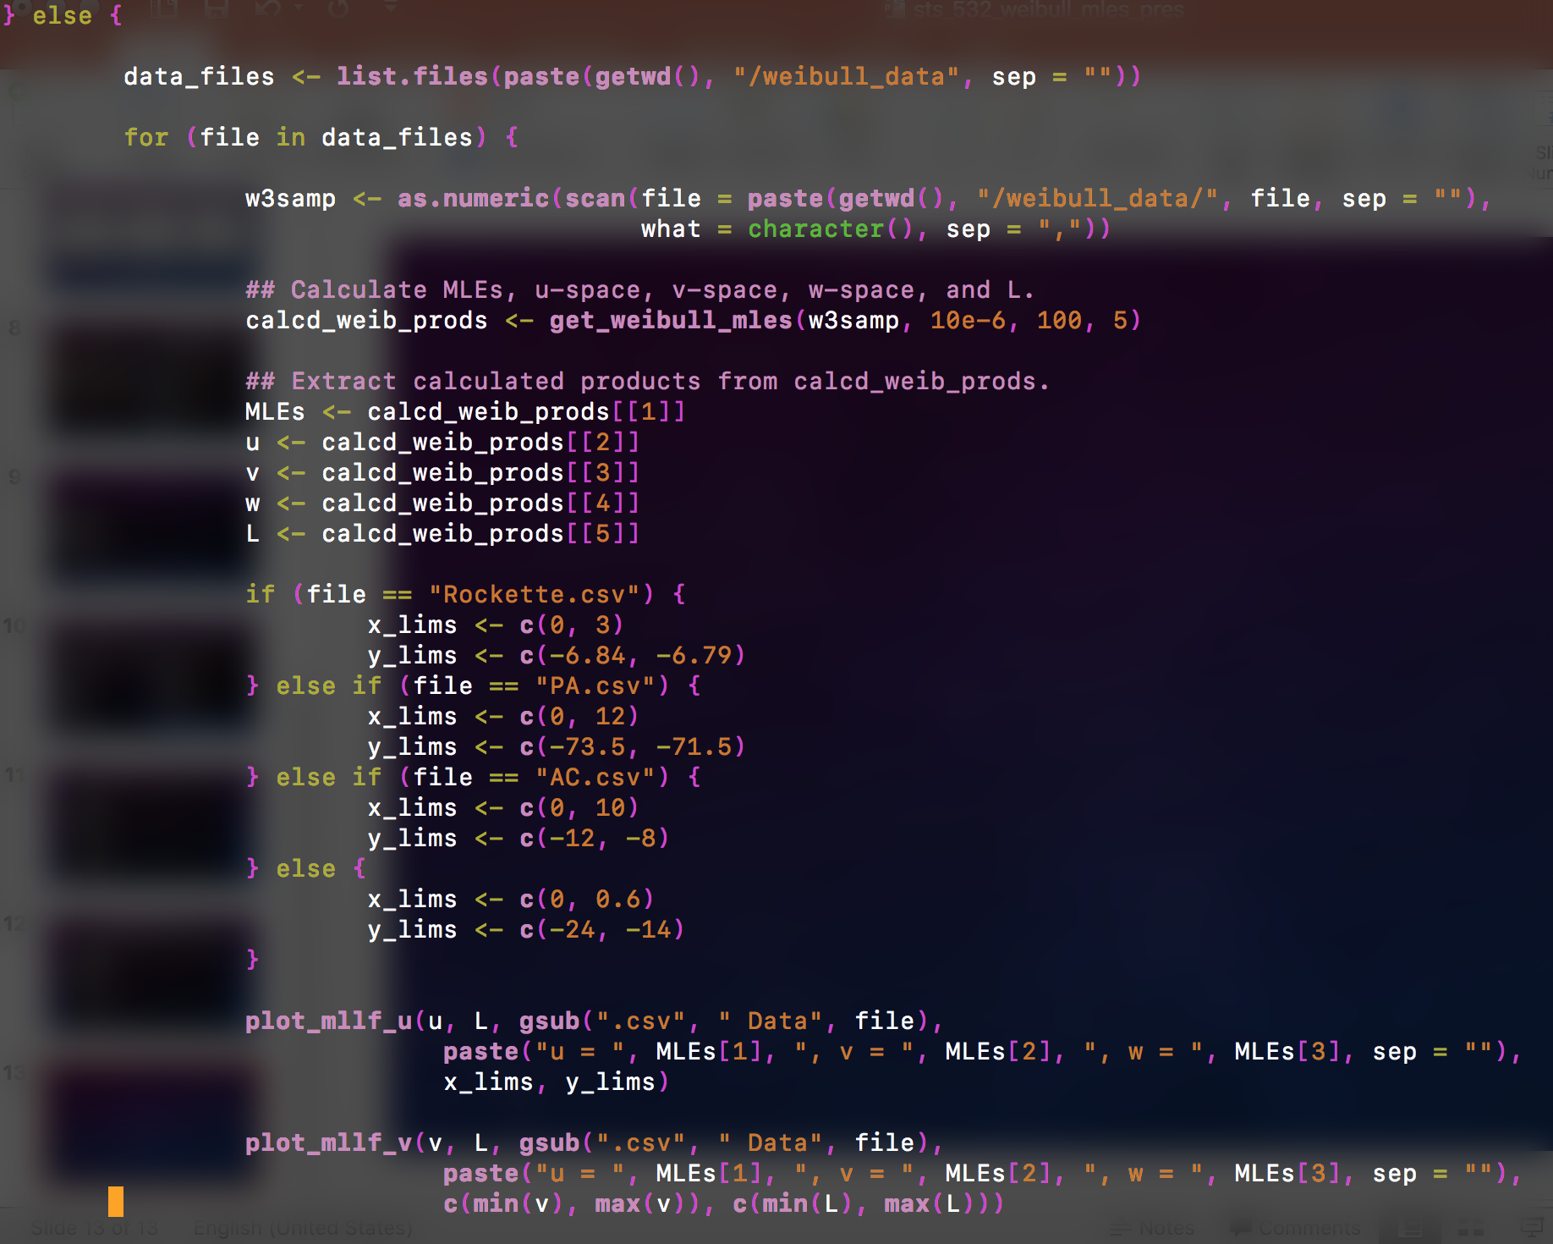
The other option is to perform the calculations for existing data sets stored on your hard drive.
The four data sets mentioned in the paper were stored on my hard drive in a folder called Weibull data.
The data was then read into the program using the scan function.

